Slide 1



Database Management And Analytics
City School of Albany
~Maaz Shaikh

Slide 2


INDEX
Schema Development
Entity Relation Diagram
Database Design and Server Deployments
Solutions
Improvements & Limitations
Conclusion
Appendix ( Contains SQL Code )

Slide 3
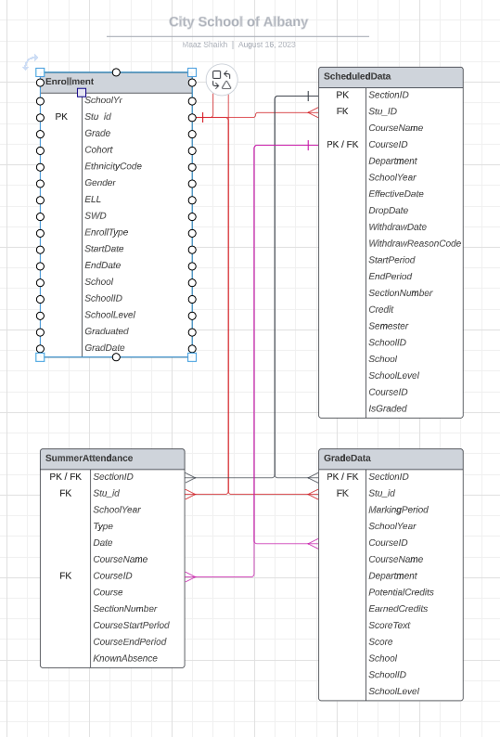
Database Design and Server Deployment (ERD)
Created chart of each table with derived schema
Established relationship between each column whilst deriving keys.
Created A Lucid Chart for better organizing and arranging data
Creating a Database and hosting it on the server deployed
Created Entity Relationship Diagram

Slide 4


Schema Development
Thorough research of Fields
Detailed Explanation and Determination of Columns in Each Table
Creating Definitions

Slide 5
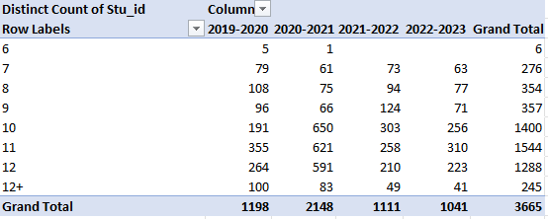
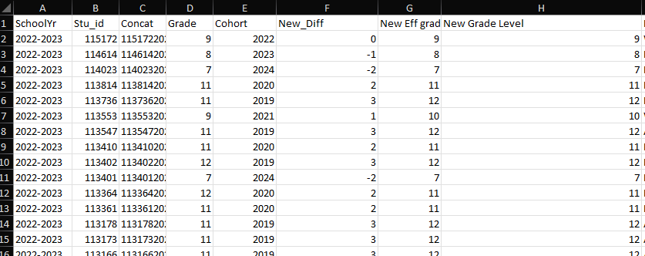
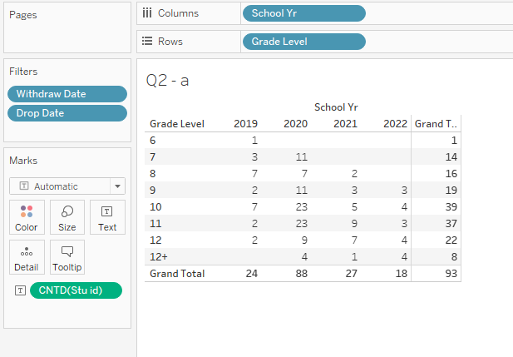
Solution – 1 & 2
1. Calculate the unique student enrollment count by grade level and school year. Use the cohort to determine the grade level.
2. Add filters for Question 1 by joining in schedule data for the ability to filter out Dropped/Withdrawn
Steps :
Created a new column called effective grade level, which is calculated from the difference between cohort year & SchoolYr
Implementation in Tableau & Excel
New_Diff = LEFT(SchoolYr,4)-Cohort
New Eff Grade = 9 + New_Diff
New Grade Level = =IF(New Eff Grade>12,"12+",New Eff Grade)

Slide 6
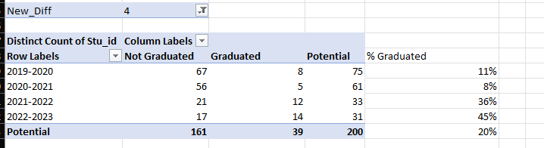
Solution - 3
Steps :
Created a new column called effective grade level, which is calculated from the difference between cohort year & SchoolYr
Steps :
Created a new column called effective grade level, which is calculated from the difference between cohort year & SchoolYr
3. Calculate the graduation rate for summer school using the enrollment data
New_Diff = LEFT(SchoolYr,4)-Cohort.
Using the New_Diff, set it = 4 as filter, to get distinct count of students who graduated

Slide 7
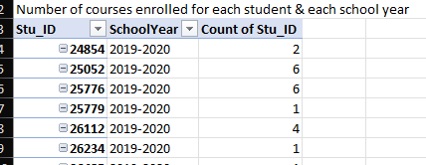
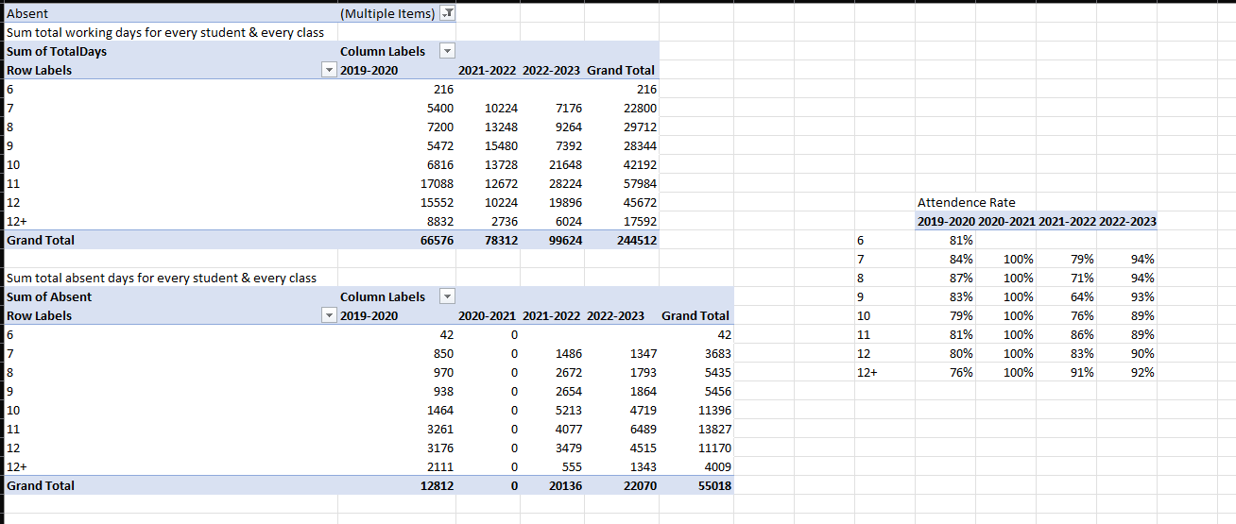
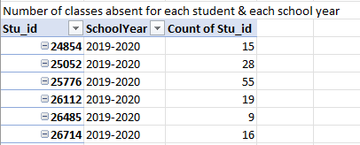
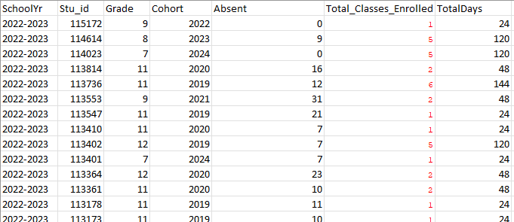
Solution - 4
Steps :
Created 2 temporary tables
1. Use scheduleData for below
4. Calculate the aggregated average of class attendance % for summer school over multiple school years
2. Use SummerAttendence for below
3. Join the above 2 tables to Enrollment sheet
Attendance Rate = (Total working days –absent days)/Total number of classes
4. TotalDays = CoursesEnrolled * 24 classes

Slide 8
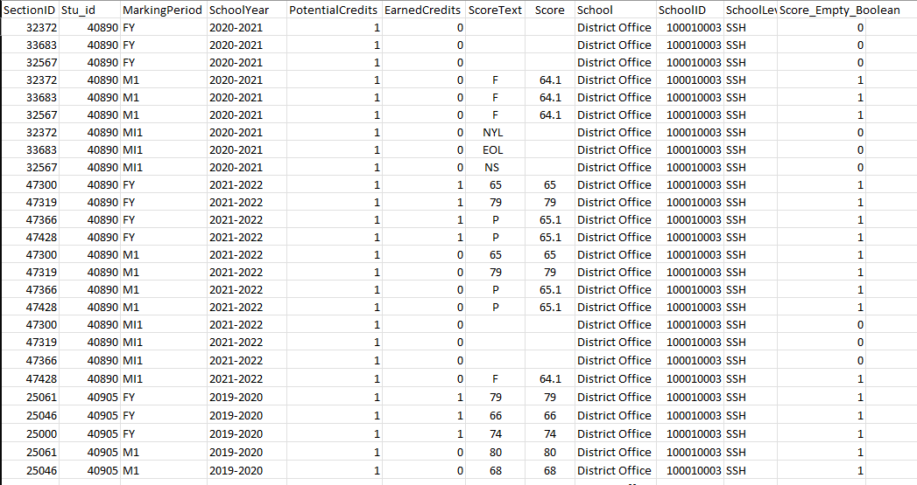
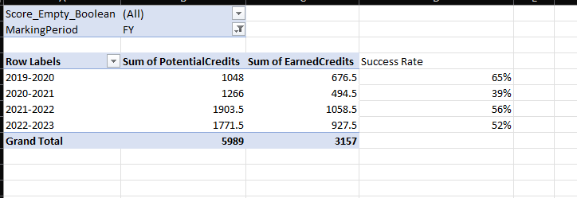
Solution - 5
Steps :
Created 2 temporary tables
Create column
Score_Empty_Boolean =IF(Score="",0,1)
5. Calculate the success rate of credits attempted versus credits earned for high school students
2. Use pivot table to aggregate sum of Potential Credits & Earned Credits per school year
3. Add filters of Score_Empty_Boolean & Marking Period as Final Year

Slide 9
Improvements and Limitations
Need of proper structured Schema
Need of proper structured ERD
Data tables contain many duplicates & unable to find primary key(‘s) for unique identification & joins.
A set of rules must be established for data collection for faster data analysis

Slide 10
Conclusion
Lucid Chart
Azure Portal (HOST)
Microsoft SSMS
Microsoft Excel
Tableau
Power BI
THANK YOU ANY QUESTIONS

